Slide 1
Tutorial 1 Learning Topology Optimization Through Examples and Case Studies
August 18, 2019

Slide 2
Problem Statement
Cantilever Beam Problem
Units: MKS
Material: AlloySteel
Structural Loads: 1000N
TopOpt Constraints: No Constraints
Objective: Minimum Compliance
Goal: Optimize the topology for a volume fraction of 0.25
1000N
Optimize the topology for Minimum Compliance

Slide 3
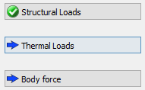
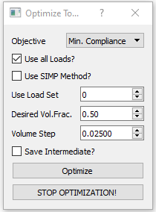
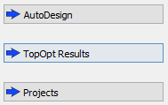
Objective: Minimum Compliance
Choose Units
Load Geometry
Define Material
Apply Loads (Structural/Thermal/Gravity)
Carry out FEA
Apply Top Opt Constraints
Topology Optimization
PostProcessing

Slide 4
Results_Minimum Compliance

Slide 5
Problem Statement
Cantilever Beam Problem
Units: MKS
Material: AlloySteel
Structural Loads: 1000N
TopOpt Constraints: No Constraints
Objective: Minimum Stress
Goal: Optimize the topology for a volume fraction of 0.25
1000N
Optimize the topology for Minimum Stress

Slide 6
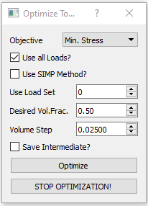
Objective: Minimum Stress
Choose Units
Load Geometry
Define Material
Apply Loads (Structural/Thermal/Gravity)
Carry out FEA
Apply Top Opt Constraints
Topology Optimization
PostProcessing

Slide 7
Results_Minimum Stress

